Slide 1
Capstone Project: AAC Adoption
Lacey Field

Slide 2

Background
The data used for this capstone was compiled by the AAC (Austin Animal Center Shelter). They compiled intakes and outtakes of animals from Oct 2013 through present. The goal was to identify the top animals to market in advertisements to boost adoptions. Animal types, breeds, and ages were evaluated, and I specifically reviewed the cases that led to adoptions and euthanizations.

Slide 3
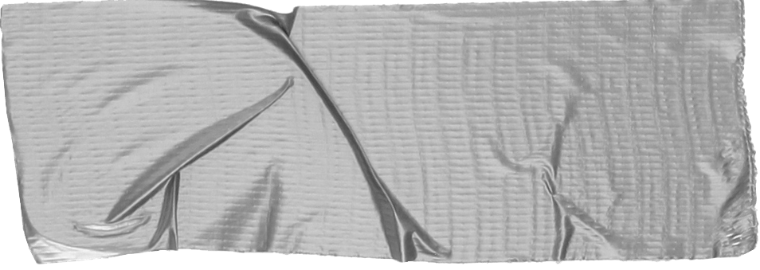

Sections
Steps taken to determine if there were significant breeds/ ages that led to more adoptions/ euthanizations
Data wrangling
Cleaned AAC data and began initial exploration
EDA
Explored data through story-telling and inferential statistics
Machine Learning
Using data to develop a predictive model

Slide 4
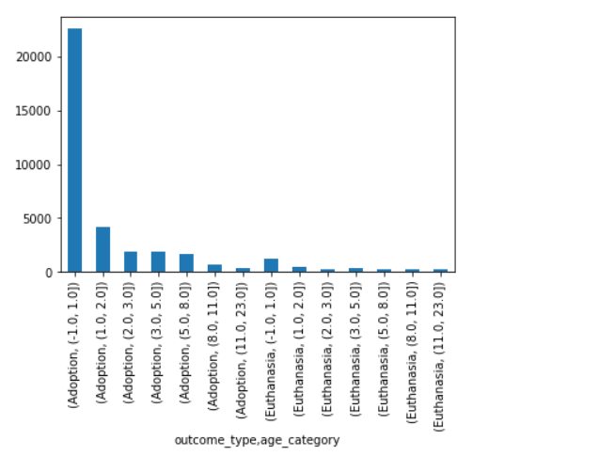
Data Wrangling:
Created datatime objects to calculate shelter length and age of outcome
Used timedelta to put into sizeable chunks
Initial EDA showed only outcome types of interest were adoption and euthanasia
EDa also showed animals should be cats/ dogs

Slide 5
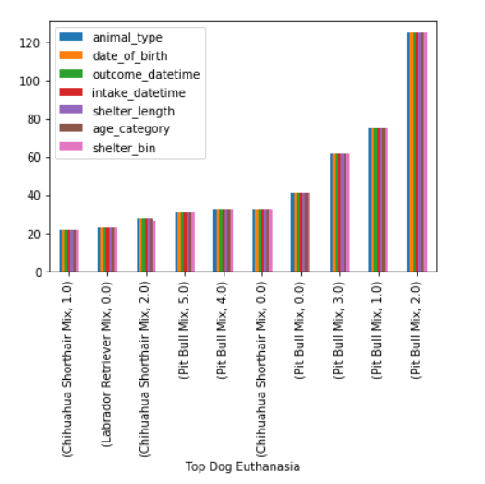
EDA
Noticed adoptions and euthanasia cases were led by younger animals
Reviewed top breeds adopted and euthanized - noticed DS mix dominated
Decided to omit cats as the breeds are not as concrete and threw off data
Once cats were removed, I reviewed the top breeds adopted and euthanized sorted by age of outcome

Slide 6
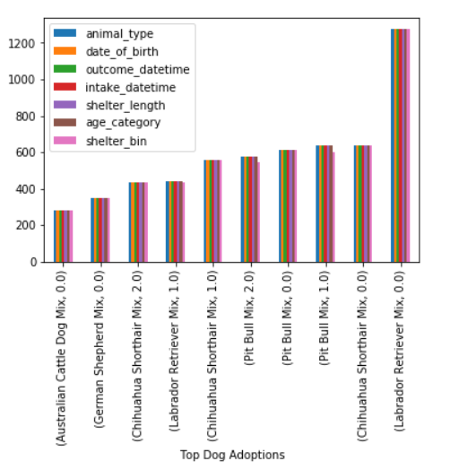
EDA
Saw that the top breed adopted was Lab Retriever Mix (0-1 yr) and led by almost double
Next top adopted breeds were Chihuahua Shorthair Mix (0-1yr) and Pit Bull Mix (1-2yr)
Euthanasia cases were led by Pit Bull Mix (0-3yr) which was surprising

Slide 7
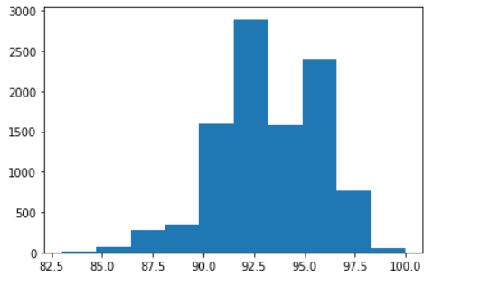
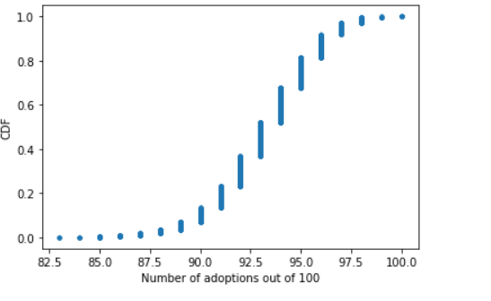
Adoptions vs Euthanasia
Wanted to check the probability of adoptions verse euthanasia cases - performed a binomial distribution through numpy.
Saw that on average 93% animals were adopted and plotted as a histogram, ECDF, and PMF

Slide 8
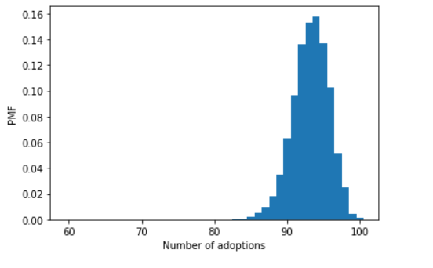
Poisson Distribution
Performed a Poisson distribution of shelter adoptions and calculated mean and percent of data under 3 years
Saw that the mean shelter length was 3 years and 64% of adoptions occurred below 4 years

Slide 9
Poisson Distributions
Performed numerous Poisson distributions to run simulations to see what conclusions could be drawn
Age of adoptions
Posson showed mean age of adoption was 1.8 and 73% were adopted under 3 years
Pit Bull Euthanized
Poisson showed mean age of euthanized was 3 yrs and 64% were euthanized below 4yrs
Pit Bull Adopted
Poisson showed mean age adopted was 1.7 yrs and 76% were adopted below 3

Slide 10
Although Pit Bulls had the highest number of euthanasia cases, 84% of all Pits were adopted

Slide 11
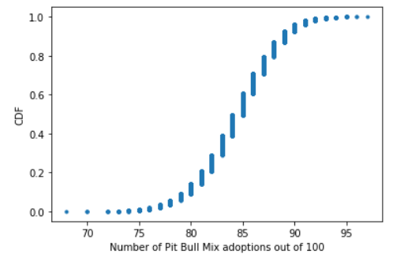
Pit Bull cont.
Performed binomial distribution on total pit bull adoptions
ECDF showed percentage of adoptions was between 75% and 90%

Slide 12
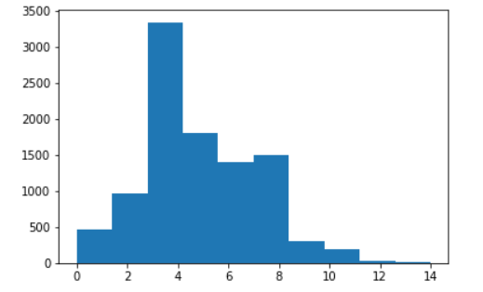
Lab Retriever
Performed Poisson distributions of Lab adoption data
Mean age adopted was 1.4 and 84% were adopted below 3yrs
Performed binomial distribution of Lab euthanized data
5% of lab mixes out of total labs were euthanized

Slide 13
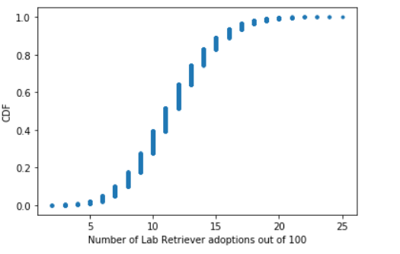
Labs adopted
Lastly performed a binomial distribution of lab mixes adopted out of total adopted cases.
Saw that lab retriever mixes account for 12% of total adopts and in simulation this ran from 5 - 20 %
Although this seemed low considering the number of adoptions was double that of the runner-up breed, I believe this may be due to people not truly specifying Labrador Retriever Mix on the shelter forms. Many people maybe just put Labrador or Retriever, which would skew the data

Slide 14
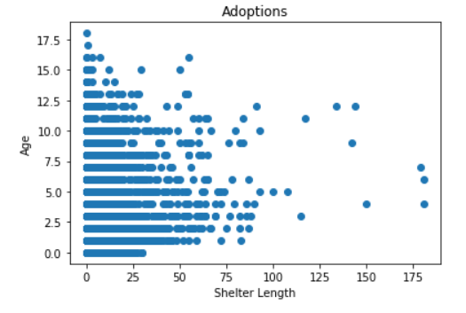
Shelter Length Vs Age of Adoption
Can age be used to predict shelter length?
Variables are not very correlated per graph on the right
Used different modeling techniques to develop and tune models using these variables

Slide 15
Types of Regressions
Performed numerous regressions to increase the score of the model and also used hypertuning to increase R**2
Linear Regression
Model is easy to use and only requires a few lines of code
OLS
Also easy to use with little code. Similar to Linear regression but gives great summary stats
Ridge/Lasso Regression
Also similar to linear regression but additional parameters to tune
Random Forest
Ensemble method that uses bagging to create numerous decision trees for averaging

Slide 16
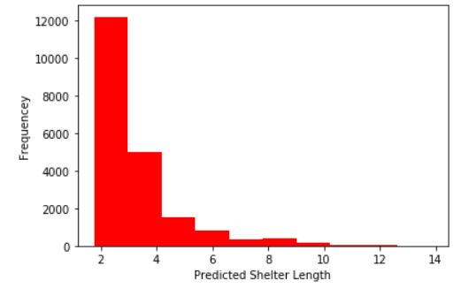
Linear/ OLS
Both models yielded low R**2 scores ~4.5%
OLS showed P > t was 0.00 showing statistically significant
Also showed predictive shelter length was 2-10 weeks - our data spans 0-175 weeks

Slide 17
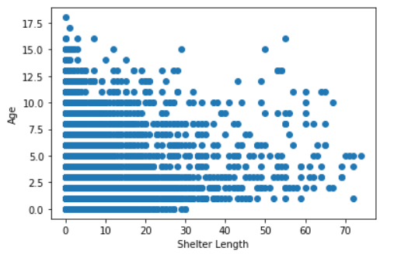
Ridge/Lasso
Used train_test_split on both models
Ridge increased the score to 4.6% with tuning
Lasso was not a good model for the data
Decided to limit shelter legnth to < 75 weeks to see if that increased score

Slide 18
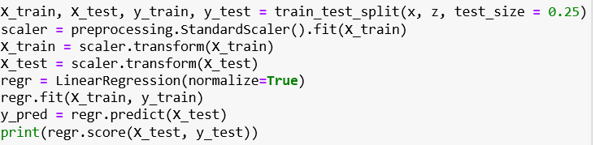
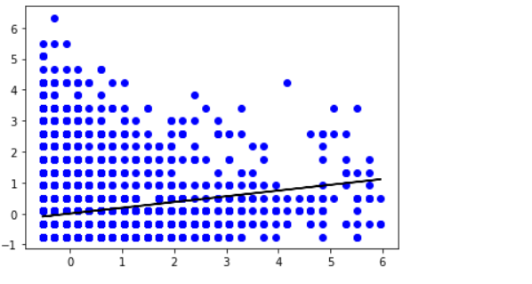
Random Forest/ Tuning
Changing shelter length did not improve model
Used Random Forest with original data set - MSE decreased. R**2 was 4.3 so not as good as linear regression
Continued to tune parameters and compare models - most successful was train test split with scaling/ normalizing and using linear regression, which yielded 6.1%

Slide 19

Tuning/ Breeds
Continued to remove outliers and play around with variables - not much improvement
Used scaling, normalizing, grid search, varying alphas/ n, did not impact the model much
Brought in breed feature to use for modeling- used get_dummies to make breeds numerical for comparison
Did not see improvement with model - resulted in large negative R**2 meaning is not modeling data at all

Slide 20
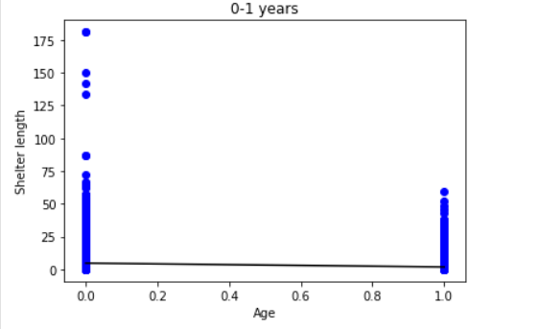
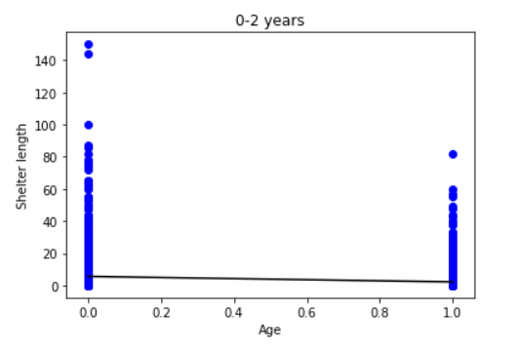
Binning Age
Also binned age into categores 0-1 years and above 1 year to see impacts
Did not notice improvements to original model
Played around with different age bins but none were improvements
Can see that many dogs 0-1/ 0-2 years are adopted up to 75 weeks in shelter

Slide 21
Animals ages 0-2 are adopted between 0 and 75 weeks - very large range that is similar to ages 2-23

Slide 22
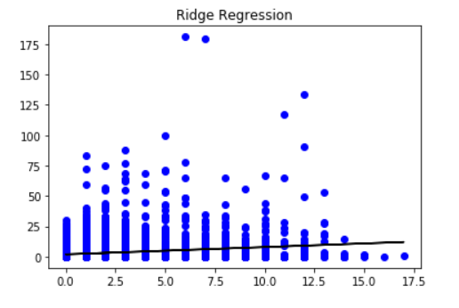
ML Take-aways
Shelter length and age are not as correlated as I thought - not easy to model due to this
Even with adding in more features and binning age, model is still underfitting data

Slide 23
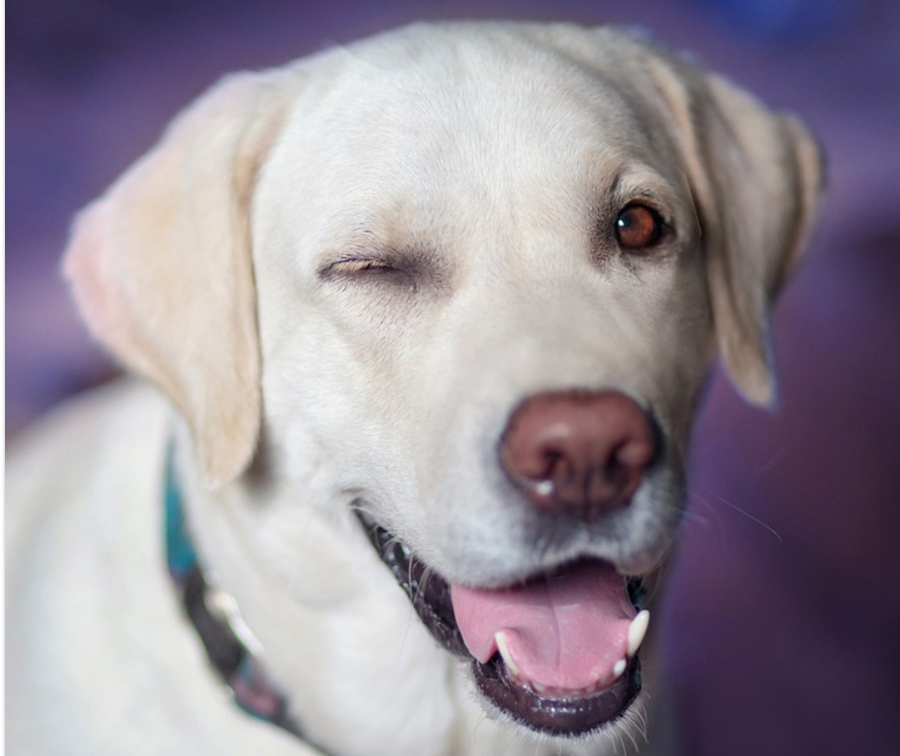
Recommendations/ Follow-ups
Do not rely on age to predict the shelter length - variables are not correlated
Boost advertisements for labrador retrievers based on statistics shown
Pit bull mixes have high euthanasia rates - follow up to see reasons for euthanizing - disease/ aggression?
Model cats to see if their shelter length and age are more correlated

Slide 24
Summary
Data Wrangling
Cleaned data and used datetime objects to calculate time frames such as age/ shelter length. Also removed outliers such as birds and transfer outcomes
EDA
Explored data more thoroughly and noticed trends in top breeds of adopted verse euthanized. Also realized cat breeds were inaccurate and removed from dataset.
Machine Learning
Used data to create predictive models via linear regression/ random forest. Noticed shelter length and age are not very correlated and thus models do not fit well. Was able to increase model performance via tuning

